Slide 1
The Voice Myanmar Information System
Nan Ei Ei Theint
Japanese & IT Batch 3
Bootstrap Project
11/3/2020

Slide 2
Introduction
The Voice Myanmar is one of the biggest international TV format.
It was started in 2018.
It contains 4 coaches and levle 1 to 6.
Winner'prize is solo album, 200 lakhs and car.

Slide 3
Objective
To save time and easy when searching for info
To refresh yourself while listening to music
To be encouraged yourself when watching this show
To excite while waching
To encourage our favourite auditions
To listen various song type

Slide 4
Implementation
Home
Season
Season1
Blind Audition
Battle Round
Live Show 1
Live Show 2
Semi Final
Final
Season2
Blind Audition
Battle Round
Knock-out Round
Live show

Slide 5
5. Semi Final
6. Final
3. Season3
1.Blind Audition
3. Coach
4. About
5. Contact

Slide 6
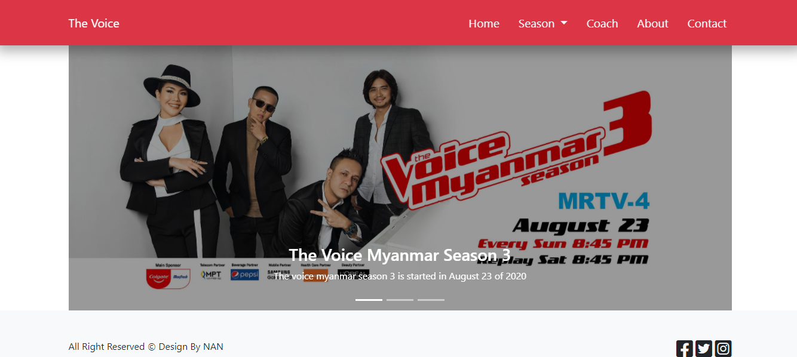
Design

